Slide 1
WECC
August 2017 Reliability Workshop James Merlo, PhD
Vice President, Reliability Risk Management
August 29, 2017

Slide 2
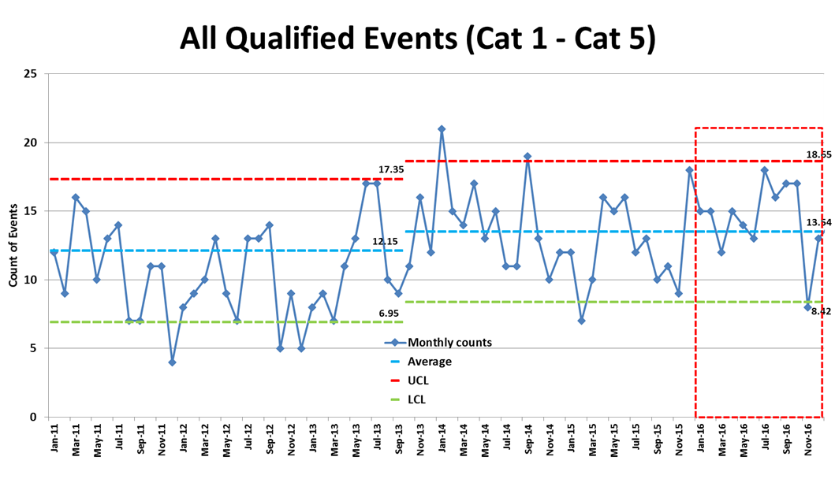
Events Analysis Process Capturing Faint Signals
Notes:
13 lessons learned published
In 2016, there were 85 non-EMS brief reports submitted to the ERO. This was a substantial increase when compared to 50 non-EMS reports submitted to the ERO in 2015. 77 of these 85 events were Category 1 events, 6 were Category 2 events and 2 were Category 3.a events in ERCOT. Subsequent to January 1, 2017, the two Category 3.a events in ERCOT would be classified as a Category 1.g event to more accurately reflect the risk associated with these events.

Slide 3
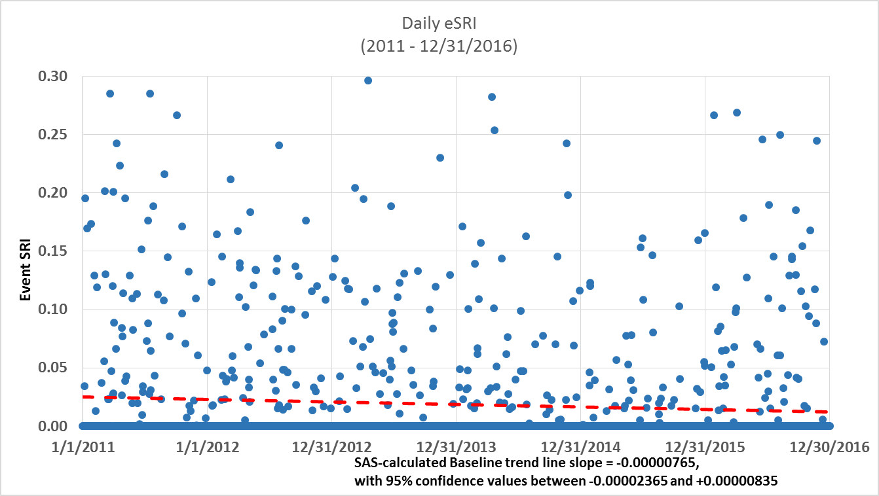
Event Severity Remains on Good Glideslope

Slide 4
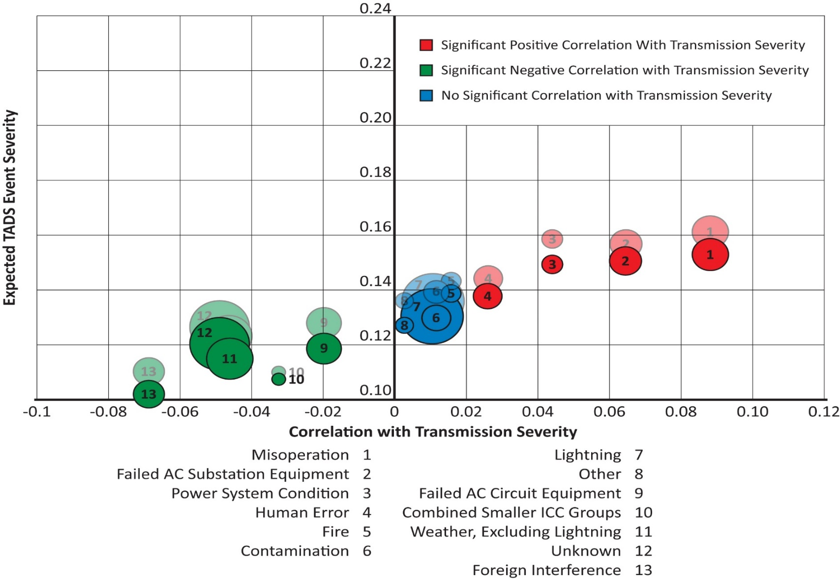
Continued Decline in Average Transmission Outage Severity

Slide 5
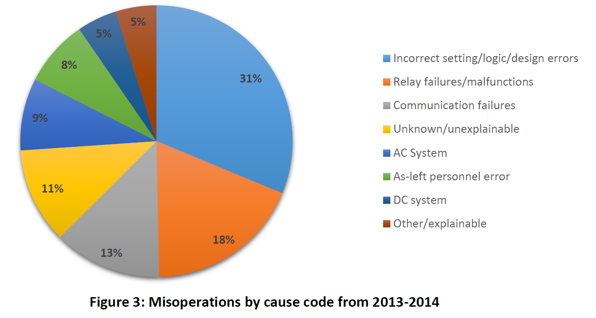
Misoperations by Cause Code

Slide 6
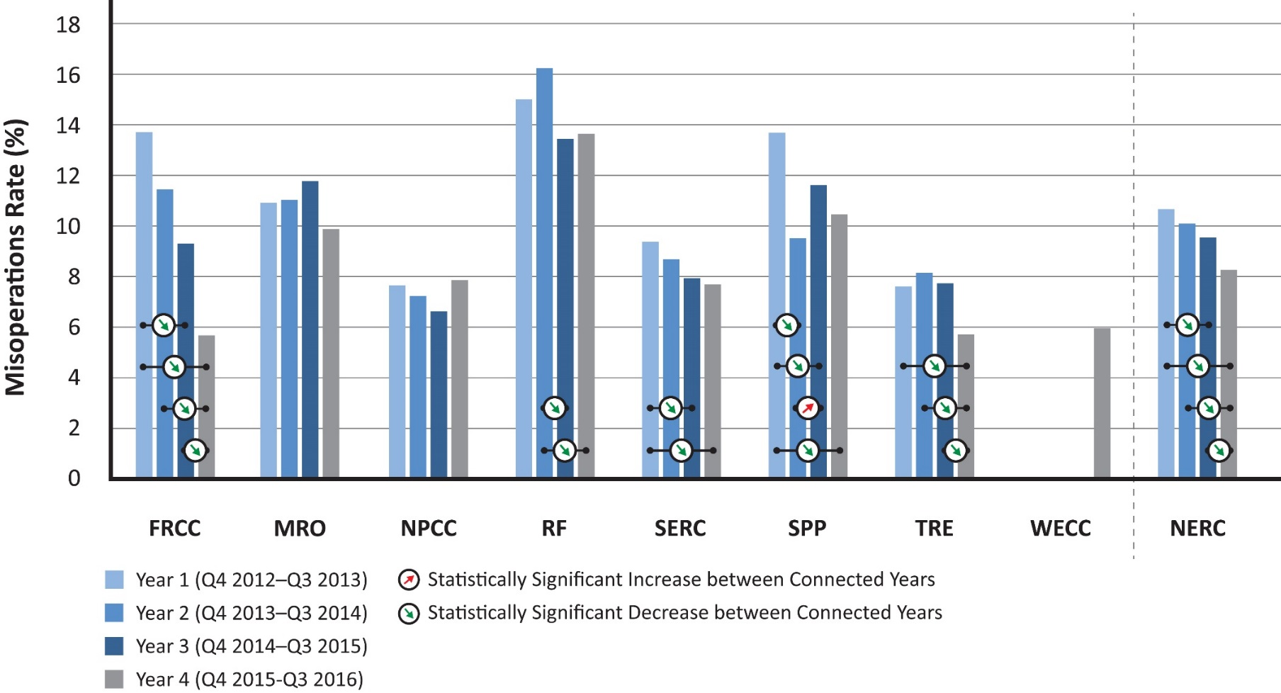
Misoperations Rates Continuing to Decline

Slide 7
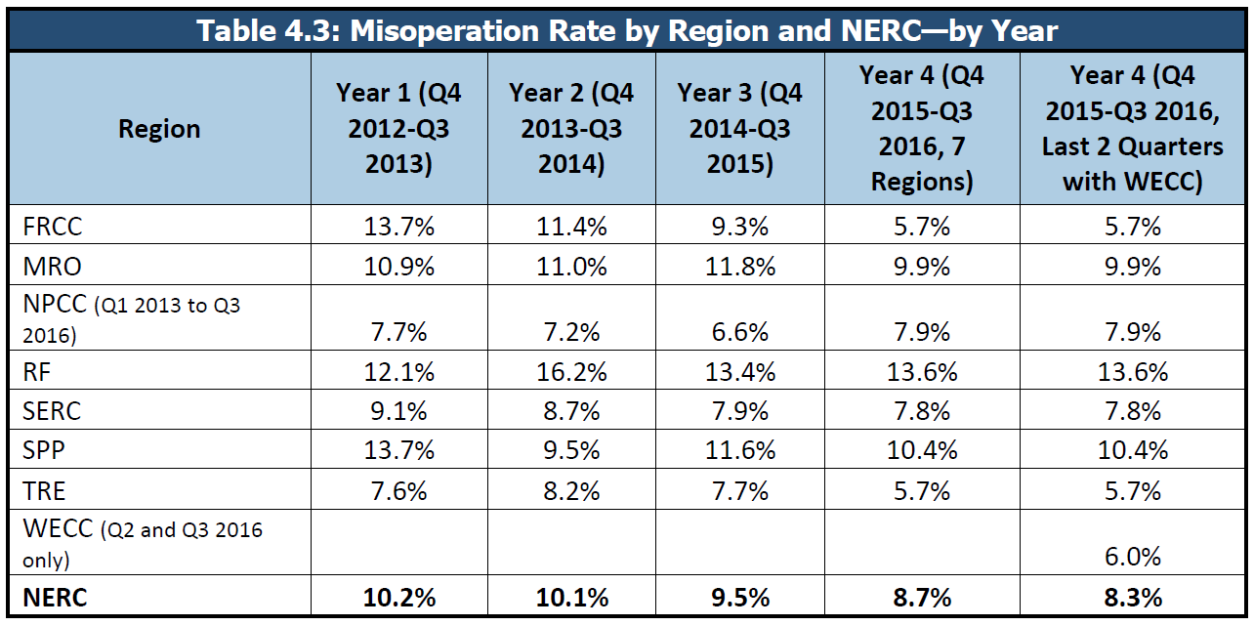
Misoperation Rate by Year

Slide 8
Sustained Outages
Table B.14: TADS Sustained Outages 100 kV+ (2015)
Sustained Cause Code | Number of Outages | Average Outage Duration (Hours) | Median Outage Duration (Hours) | Maximum Duration (Days)
Failed AC Circuit Equipment | 1248 | 56.9 | 12.8 | 161.4
Failed AC Substation Equipment | 813 | 25.8 | 2.8 | 48.8
Weather- excluding lightning | 796 | 14.3 | 1.1 | 107.8
Unknown | 727 | 4.7 | 0.1 | 19.0
Other | 682 | 7.0 | 0.4 | 49.8
Misoperation | 565 | 11.1 | 0.9 | 34.5
Foreign Interference | 411 | 10.0 | 2.1 | 25.6
Lightning | 405 | 5.8 | 0.1 | 37.6
Human Error | 344 | 4.2 | 0.2 | 18.9
Power System Condition | 326 | 29.4 | 0.3 | 111.9
Vegetation | 321 | 23.1 | 8.7 | 25.3
Fire | 88 | 33.3 | 2.9 | 52.9
Contamination | 76 | 8.9 | 1.6 | 5.6
Environmental | 38 | 32.1 | 3.9 | 21.7
Vandalism- Terrorism- or Malicious Acts | 5 | 6.1 | 5.5 | 0.7
Grand Total | 6845 | 21.6 | 1.7 | 161.4

Slide 9
Sustained Outages
Table B.14: TADS Sustained Outages 100 kV+ (2015)
Sustained Cause Code | Number of Outages | Average Outage Duration (Hours) | Median Outage Duration (Hours) | Maximum Duration (Days)
Failed AC Circuit Equipment | 1248 | 56.9 | 12.8 | 161.4
Failed AC Substation Equipment | 813 | 25.8 | 2.8 | 48.8
Weather- excluding lightning | 796 | 14.3 | 1.1 | 107.8
Unknown | 727 | 4.7 | 0.1 | 19.0
Other | 682 | 7.0 | 0.4 | 49.8
Misoperation | 565 | 11.1 | 0.9 | 34.5
Foreign Interference | 411 | 10.0 | 2.1 | 25.6
Lightning | 405 | 5.8 | 0.1 | 37.6
Human Error | 344 | 4.2 | 0.2 | 18.9
Power System Condition | 326 | 29.4 | 0.3 | 111.9
Vegetation | 321 | 23.1 | 8.7 | 25.3
Fire | 88 | 33.3 | 2.9 | 52.9
Contamination | 76 | 8.9 | 1.6 | 5.6
Environmental | 38 | 32.1 | 3.9 | 21.7
Vandalism- Terrorism- or Malicious Acts | 5 | 6.1 | 5.5 | 0.7
Grand Total | 6845 | 21.6 | 1.7 | 161.4

Slide 10
System Dynamic Character is Changing
Retirement/displacement of conventional generation
Variable energy resources
Rapid penetration of electronically-coupled resources
Essential Reliability Services
Reduced inertia
Frequency Reponses
Voltage Support
Ramping and flexibility needs
Rapid penetration of new loads
System controls and protection coordination
Modeling and simulation constraints
Increasing interface with distribution-centric resources

Slide 11
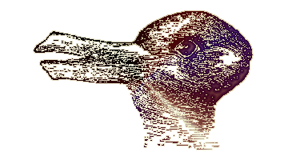
Human Error

Slide 12
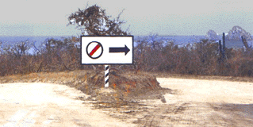
Which Direction?

Slide 13
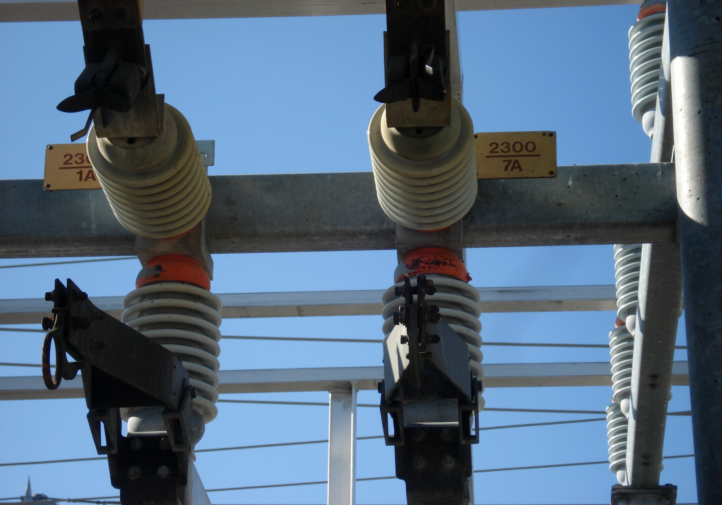
Work as Planned

Slide 14
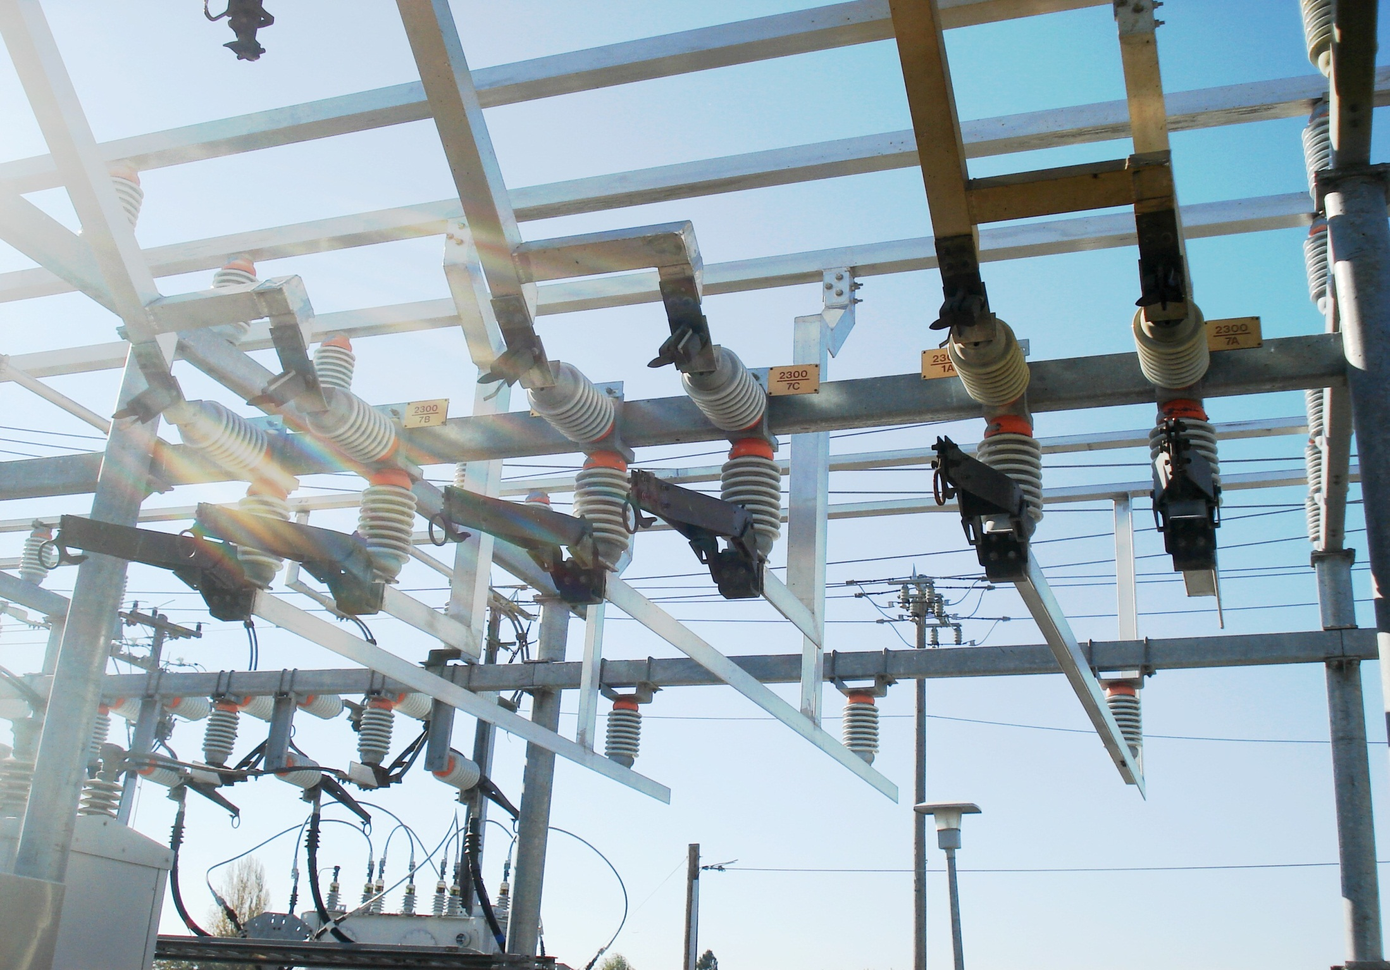
Work as Executed

Slide 15
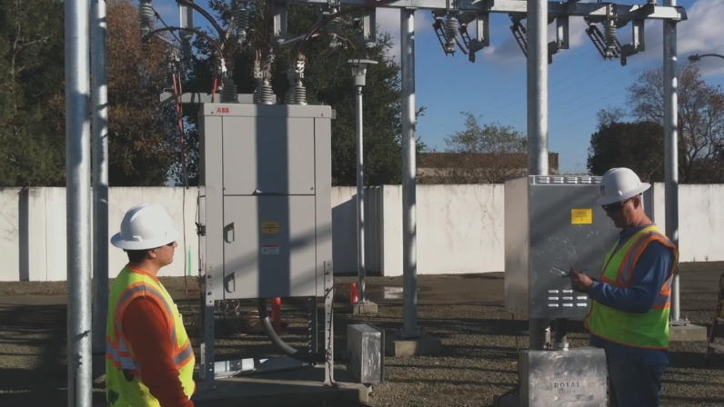
Human Capital

Slide 16
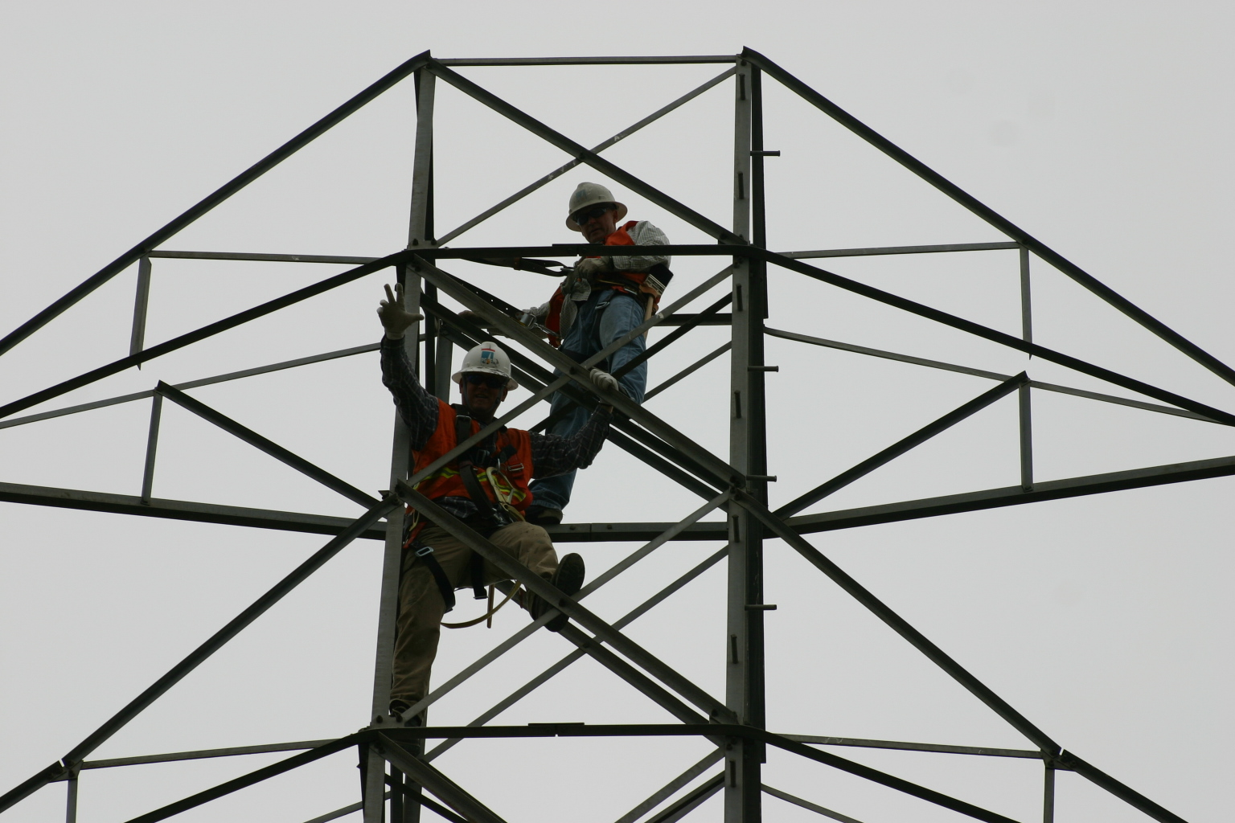
All Trying to do the Right Thing

Slide 17
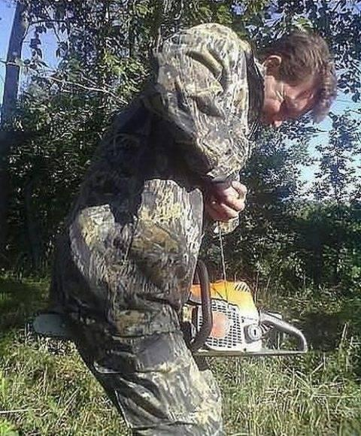
Sometimes it is a Human

Slide 18
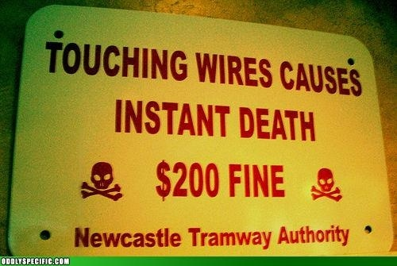
Your Artifacts Help Define You

Slide 19
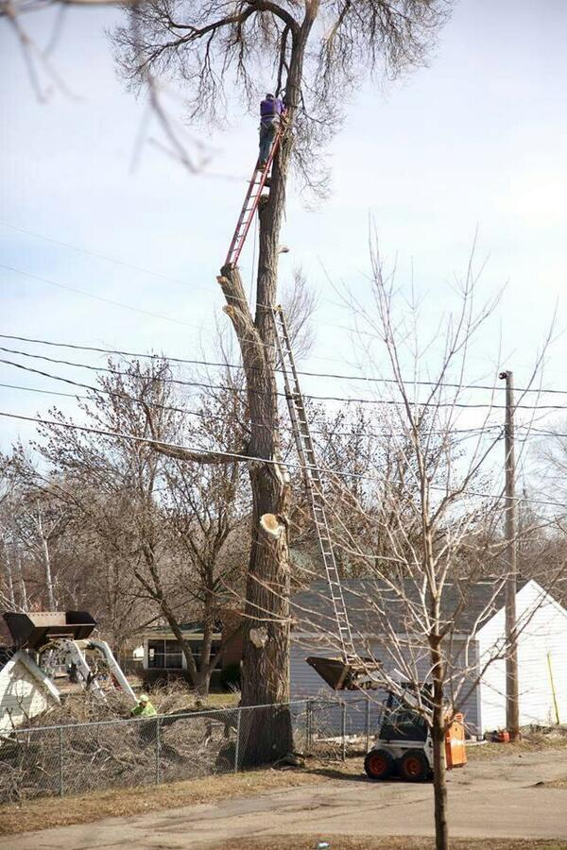
Risk versus Consequences

Slide 20
Event Analysis and Compliance
Event
Report
(EA Process)
Improved Reliability
Review
Refine
Cause Analysis
Trend Analysis
Incentives and Credit
Event
Self assessment
RISK?
Monitor
High
Emphasis on Data and Analysis
Less than adequate
Refine
with entity
Trend Analysis
Improved
Information to Industry
Quality
Compliance
Assessment
Investigate
Spot Check
Data Submittal
Add to Audit
No action
Report PV as necessary
No Report
Risk
Fair
Treatment
Registered Entity
Regional Entity
Quality Review and PV Screen
NERC
Support and Oversight
Decision Point
Notes:
Reconciliation of data, trend analysis; Conduct GAP analysis on Standards and Compliance Monitoring Program
Improved; Lessons Learned, Guidelines, Standards, Monitoring, Education, Training

Slide 21
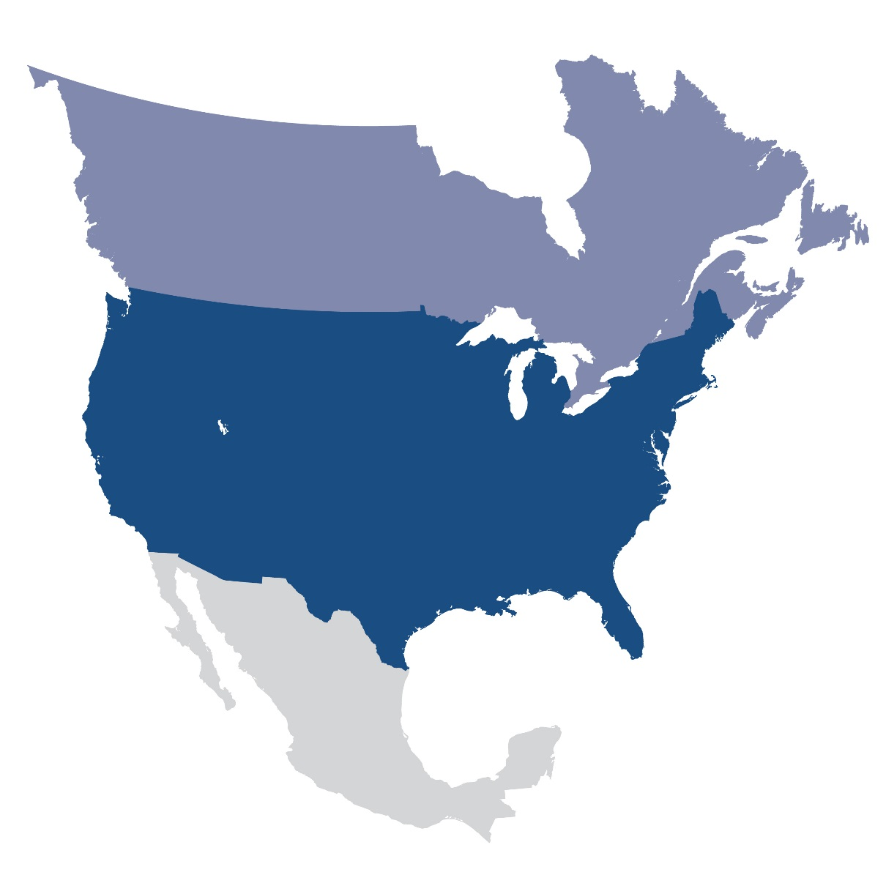
Questions and Answers

